Slide 1
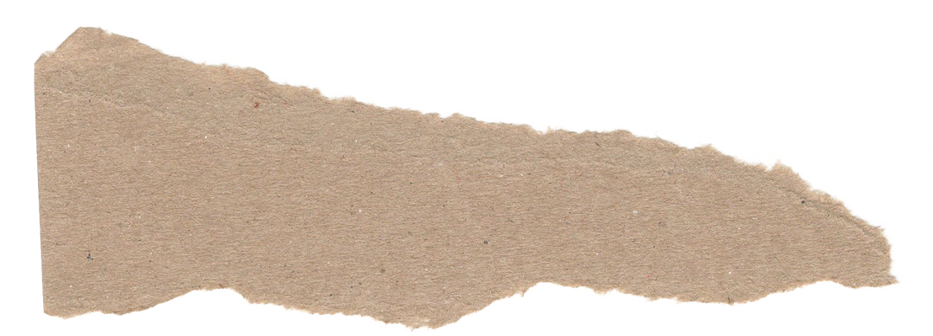

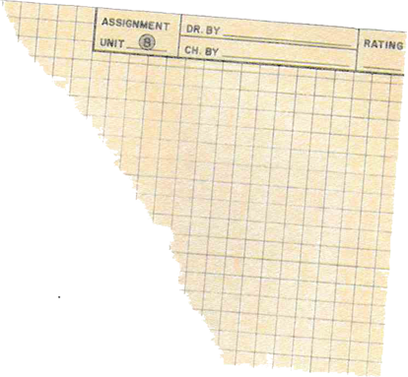






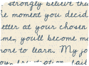
SUBHAVARSHA
YUVARAJ
HIRE ME!!

Slide 2
AREAS OF INTEREST
DIGITAL ELECTRONICS
C PROGRAMMING
HTML & CSS

Slide 3








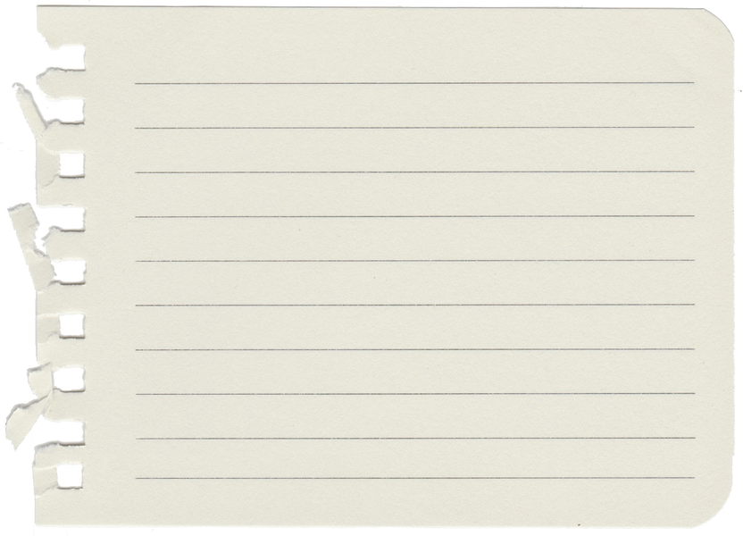



TOOLS

Slide 4



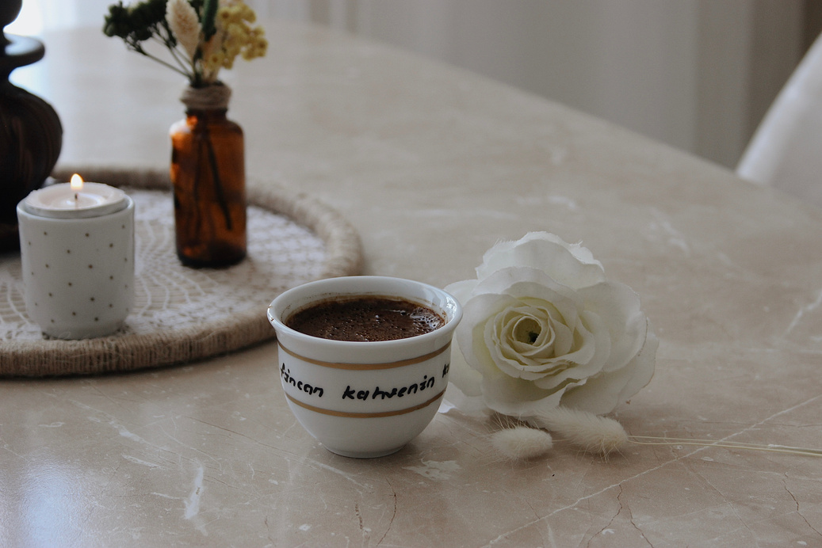

Achievements
Received RAJYAPURASKAR award from from our Hoourable Ex- Governor in the year 2019.
Presented a project on AUTOMATION IN CAR PARKING and won 3rd place at KEC
Presented a paper on THERMAL GOGGLES and won 2nd place at IEEE event

Slide 5








Languages Known
TELUGU
This is my mother tongue and I have a good speaking skill.
I have a good fluency in English, Tamil with speaking, reading, writing skills.
GERMAN
I took an interest to learn an add - on language. I have a good writing and reading skill.

Slide 6






Inplant Trainings
Inplant training at JSW, Salem -
between 2021-2022.
INTERNSHIP AT CODSOFT - FEB 2024.
INPLANT TRAINING AT CODE BIND TECHNOLOGIES - BETWEEN 2022-2023

Slide 7










Member at IEEE
Joint Secratary of Rotaract Club of KEC
Clubs
Doc & MoC head at IIC
Member at IETE

Slide 8


Let’s Work
Together

